Slide 1

Shri Vaishnav Vidyapeeth Vishwavidyalaya
Shri Vaishnav Institute of Information Technology
PROJECT PRESENTATION
Voice Command Assistant
By: Shubham Tripathi
Enrollment No.- 21100BTCSAII09446
Subject - SEPM
(Software Engineering & Project Management)
Subject Code- BTCS-504
Class- B-Tech CSE –AI(IBM)
Section – “ D”
Year – 3rd Semester – 5th

Slide 2
INTRODUCTION
This is a Software Requirements Specification (SRS). The main objective of this document is to illustrate the requirements of the project Data Science Multi-disease prediction system. The document gives the detailed description of the both functional and non-functional requirements proposed by the client. The purpose of this project is to provide a user-friendly environment to patients for identifying disease.

Slide 3
Project Idea
Project Goal
The aim of this study is to develop a voice controlled personal assistant that will run as a desktopapplication that will aid its users (primarily the elderly and disabled perform various operations throughvoice commands, and in so doing simplify basic operations
carried out on their personal computer likelaunching of programs, checking the time, opening websites, playing music etc. The objective of this study is to develop a system that should:
1. Function as a desktop application to aid visibility, since elderly people findit hard to use smart phoneapplications due to the size of their screens.
2. Possess a simple Graphical User Interface that will allow users interact easily with the application

Slide 4
Project Idea
Target Audience
Our target audience is a computer user who wants to complete various task by just one voice command. With minimum efforts. Anybody can use this voice command assistant as per there needs.

Slide 5
Features
Major Features:
You can search any location
Search weather of any city
Fetch details from Wikipedia
Calculation
Play songs from youtube
Seatch teamprature details
Ask any jokes.
Google search

Slide 6
PROBLEM
Security could be an issue
'Even if Amazon doesn't do anything questionable with Echo interactions, it does store them in the cloud, which isn't totally hacker-proof,'
A microphone in your home
The always-on speakers don't record or send your voice commands until you use the wake word. But if having a microphone constantly listening bothers you, it can be easily turned off for privacy.
Voice recognition isn't perfect
Voice recognition has come a long way in recent years, and Amazon and Google's tech is among the best so far. However, it's still not perfect, and you might find that you still have to occasionally repeat yourself to make the smart speaker understand your command.
It’s not connected with home appliances , so it cannot help you to turn on the appliances by your command.

Slide 7
SYSTEM ANALYSIS
Systems analysis is the process by which an individual studies a system such that an information system can be analyzed, modeled, and a logical alternative can be chosen. Systems analysis projects are initiated for three reasons: problems, opportunities, and directives.

Slide 8
Functional Requirements
User must be aware about the activavtion command of the assistant
User must be able to get the internet access to run the application.
User can retrieve all the details of the application.

Slide 9
Non-Functional Requirements
User friendly interface, for a smooth experience.
Scalability, voice command assistant should be able to provide instant results of the desired task requested by the user.
Performance, it should be lightweight which means it should not add heavy load to the network.
Secure, the documents should not contain any kind of malware or virus.

Slide 10
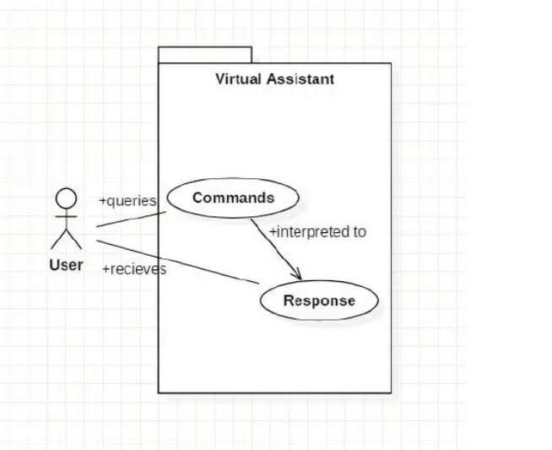
USE CASE DIAGRAM

Slide 11
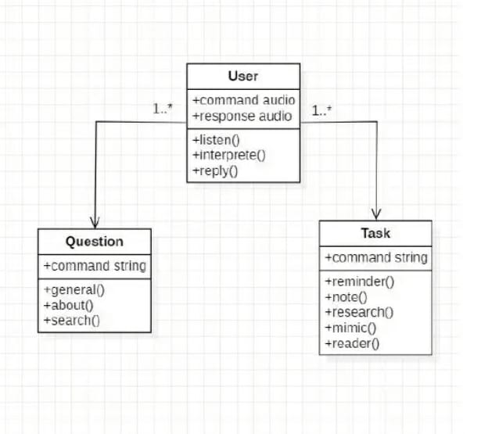
CLASS DIAGRAM

Slide 12
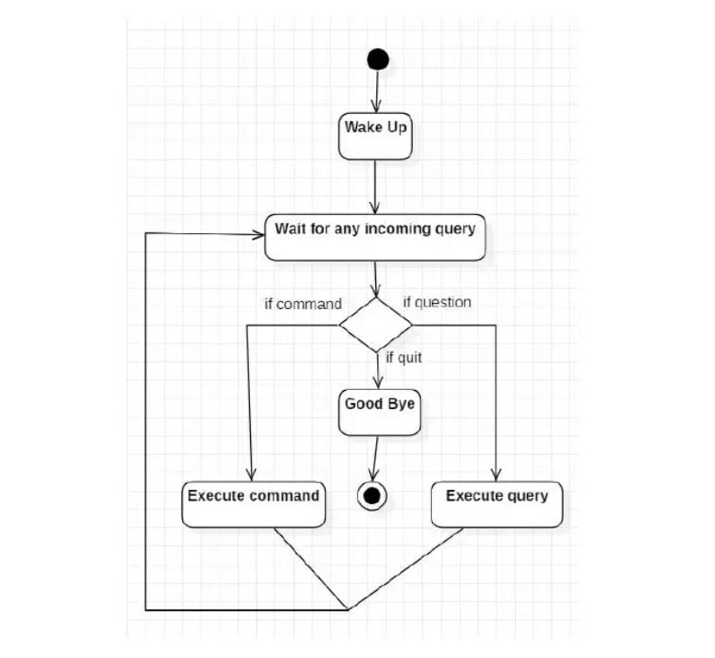
ACTIVITY DIAGRAM

Slide 13
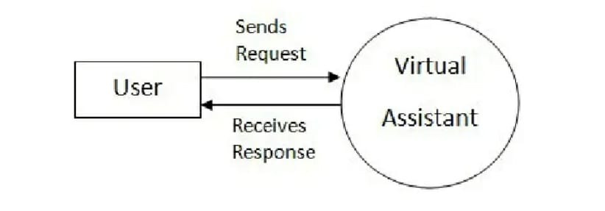
DATA FLOW DIAGRAM

Slide 14

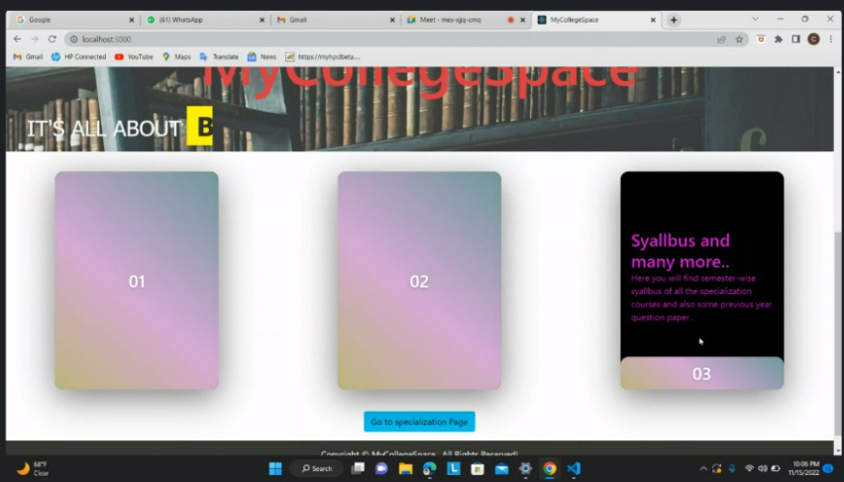
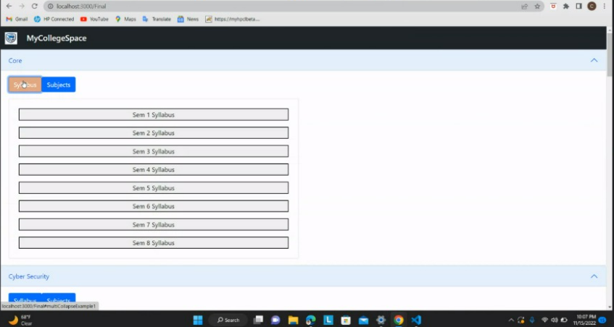
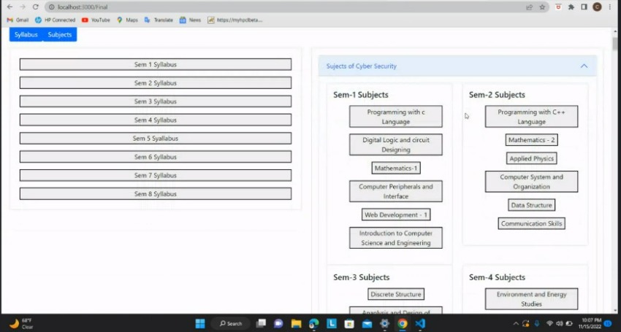
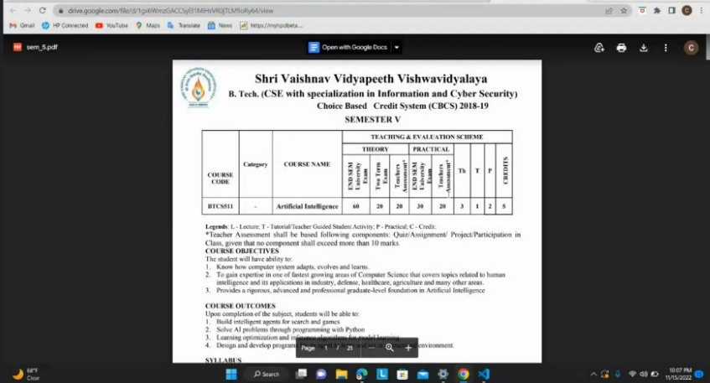
RESULT

Slide 15
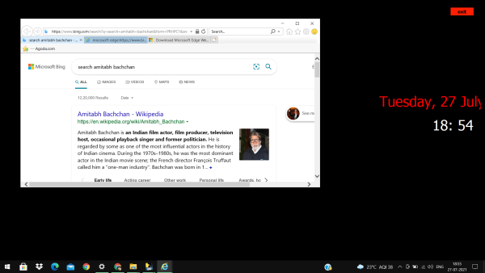

Slide 16
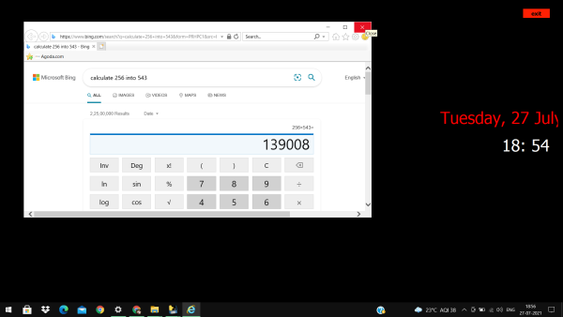

Slide 17
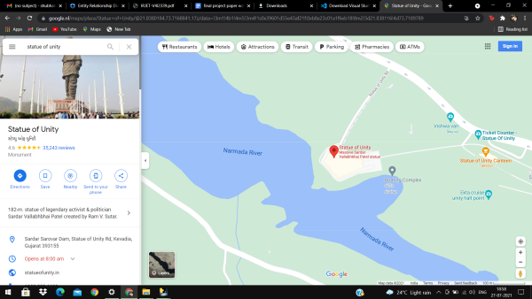

Slide 18
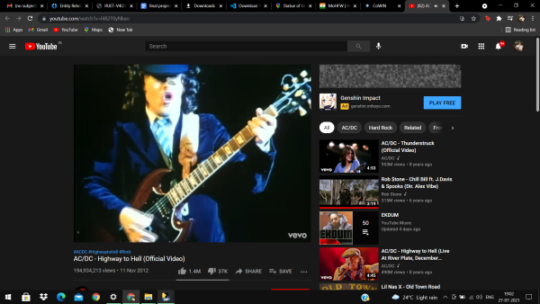

Slide 19
LIMITATIONS
Internet Connectivity: Since our application is only accessible by internet, the user must have a strong/decent internet connection, to surf.
Awareness: To increase popularity, our application should be well-known by users.
.

Slide 20
FUTURE CSOPE
Sometimes speech recognition isn’t work perfectly, and you might find that you still have to occasionally repeat yourself to make the smart speaker understand your command. So we have to make it more reliable and accurate for better speech recognition experience
This voice command assistant is not connected with home appliances. So we have to connect it with raspberry pi and and providing a connection between assistant and the home appliances
This assistant is still not connected with artificial intelligence (AI). so it can not predict your mood and answer according to it just like alexa. So we have to connect it with artificial intelligence (AI)

Slide 21
conclusion
Through this voice assistant, we have automated various services using a single linecommand.
It eases most of the tasks of the user like searching the web, retrieving weatherforecast details,
vocabulary help and medical-related queries. We aim to make this projecta complete server assistant
and make it smart enough to act as a replacement for a generalserver administration. The plans
include integrating Jarvis with mobile to provideexperience between the two connected devices.
The functionality would be seamlessenough to replace the Server Administrator with Jarvis.

Slide 22
THANKYOU

